Slide 1

DEEPFAKE TECHNOLOGY
Types and Applications

Slide 2

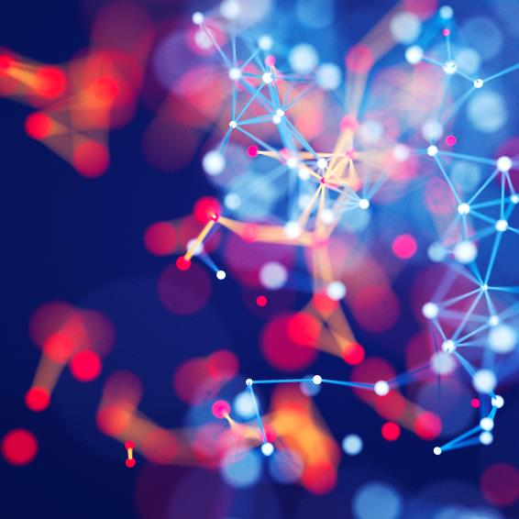
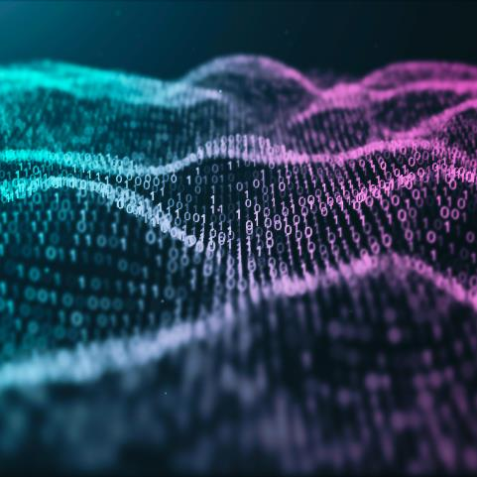
Agenda
Introduction to Deepfake Technology
History of Deepfake Technology
Types of Deepfakes
Video Deepfakes
Audio Deepfakes
Image Deepfakes
Text Deepfakes
Tools and Services for Creating Deepfakes
Applications of Deepfake Technology
Tools and Services for Detecting Deepfakes
Future Scope of Deepfake Technology
Examples of Deepfakes
Case Studies
Conclusion
References

Slide 3



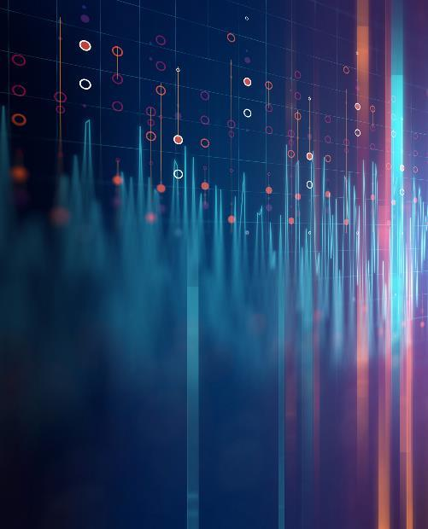
Introduction
A technology that uses deep learning to create fake Videos, Audios , Images and Text that appear real.

Slide 4

History
1950 – Introduction of AI and Computer Graphics
1970 - Introduction of digital image processing techniques.
1990 - Growth in machine learning research.
1997 - Introduction of the deep learning concept.
2014 - Introduction of the GANs ( Generative Adversarial Networks ) by Ian Goodfellow
2017 - Use of GANs to create fake images.
2018 - High-profile deepfake videos and OpenAI created GPT-2.
2019 - Development of deepfake detection tools by tech companies.
2020- Introduction of GPT-3.
2022- use of deepfakes in commercial applications.
2023- Deepfake Audio

Slide 5
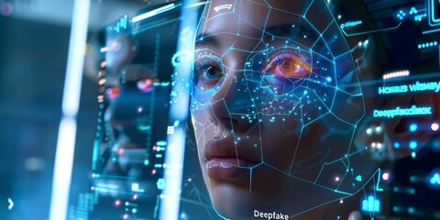
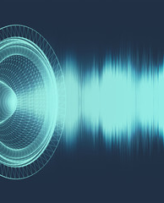
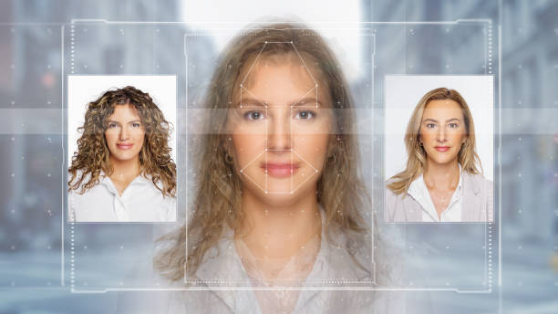
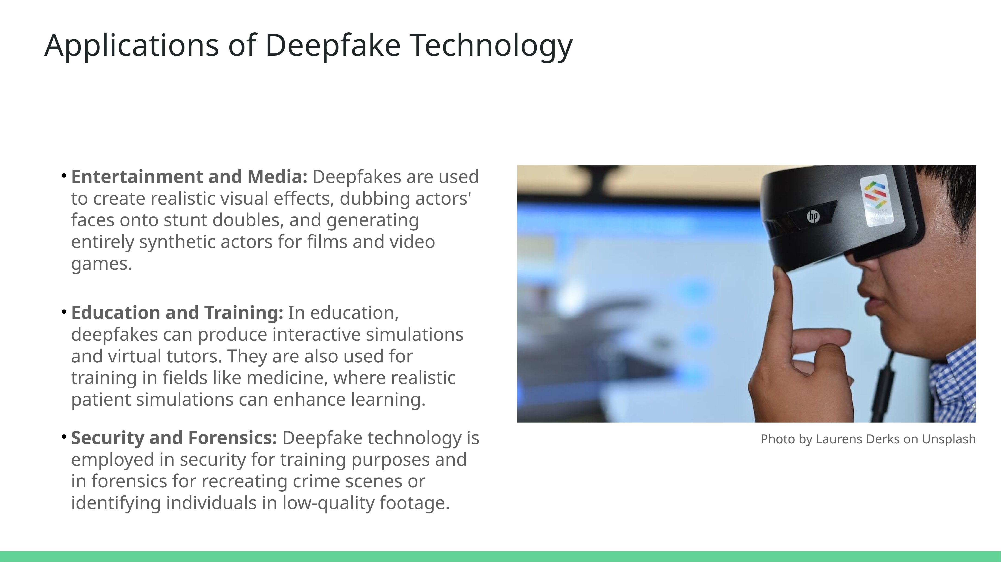
Types of Deepfakes
Types
Video Deepfakes
Audio Deepfakes
Image Deepfakes
Text Deepfakes

Slide 6

Video Deepfakes
A technology that uses deep learning to create fake videos that look real.
How Do They Work?
Data Collection: Large datasets of images/videos.
Generation: GANs produce high-quality fake videos.
Training: Use Neural networks

Slide 7
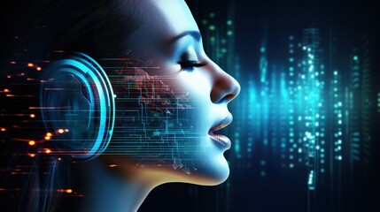
Audio Deepfakes
A technology that uses deep learning to create fake audios that look real.
How Do They Work?
Data Collection: Collect voice samples.
Generation: GANs produce high-quality fake audio.
Training: Use Neural networks, learn speech patterns

Slide 8
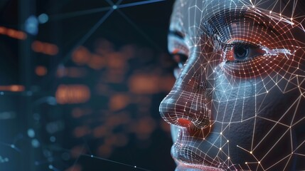
Image Deepfakes
A technology that uses deep learning to create fake Image that look real.
How Do They Work?
Data Collection: Large datasets of images.
Generation: GANs produce high-quality fake Images.
Training: Neural networks learn real images.

Slide 9
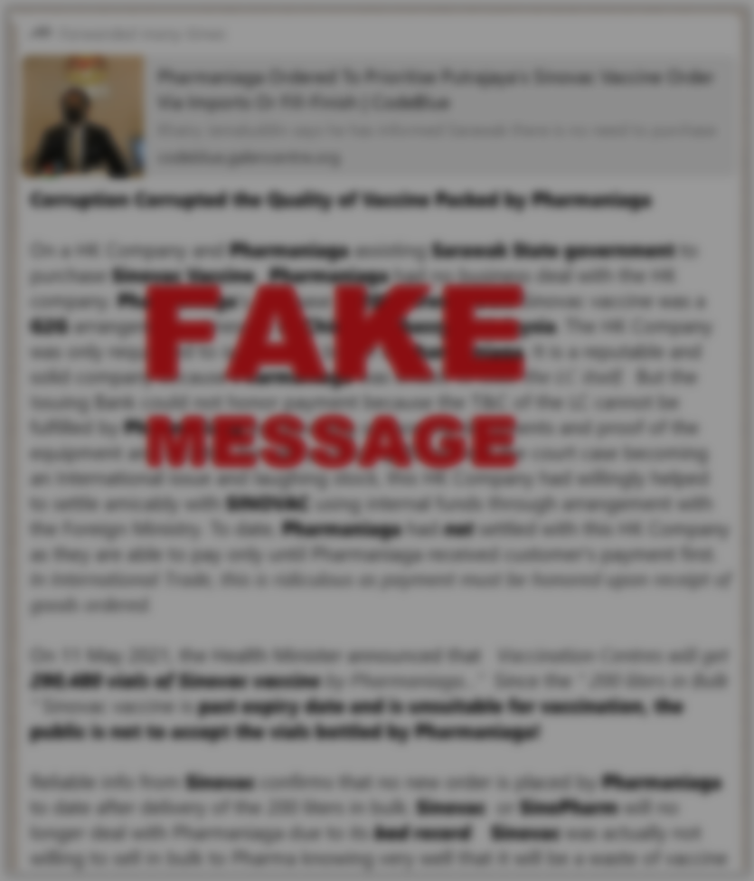
Text Deepfakes
AI-generated text that mimics human writing to look real.
How Do They Work?
Data Collection: Large datasets of text, such as books, articles, and online content.
Generation: Created AI-generated text
Training: Language models like GPT, learn patterns, styles from the text data.

Slide 10
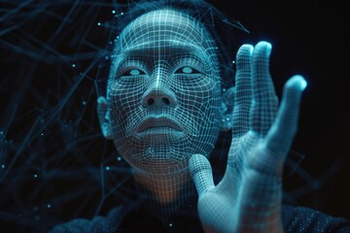
Tools and Services for Creating Deepfakes
DeepFaceLab
FaceSwap
FakeApp
DeepNude
Reface App
GPT-2
GPT-3
iSpeech

Slide 11

Applications
Positive Applications
Movies and TV
Voice dubbing
Historical Education
Training
Marketing
Art
Medical Training
Therapy
Gaming
Advertising
Music
Language education

Slide 12
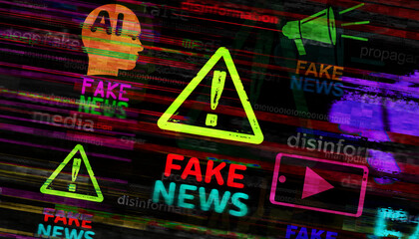
Applications
Negative Applications
Fake News
Blackmail
Job Scams
Fake Customer Reviews
Fake Marketing
Gaming Cheating
Social Engineering
Fake Emergency Calls
Fake Text Messages
Political Manipulation
Data lost
Exam scams

Slide 13


What is a Deepfake Detection Tool?
A Deepfake Detection Tool is a software or system designed to identify and detect deepfake videos or images.

Slide 14
Tools and Services for Detecting Deepfakes
Google's Assembler
OpenFace
Forensic Analysis Tools
FaceForensics++
OpenAI GPT-4 Detection
Grover
GLTR (Giant Language Model Test Room)
FaceForensics
FaceFinder
DeFake

Slide 15
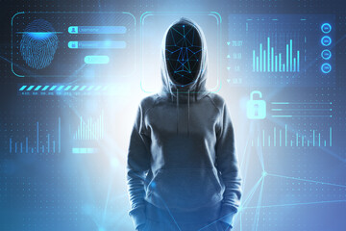
Future Scope of Deepfake Technology
Entertainment and Media
Advertising and Marketing
Education and Training
Art and Creativity
Politics And Misinformation
Privacy and Security
Regulation and Ethics

Slide 16
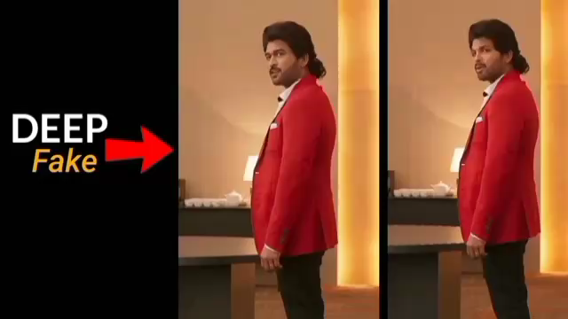
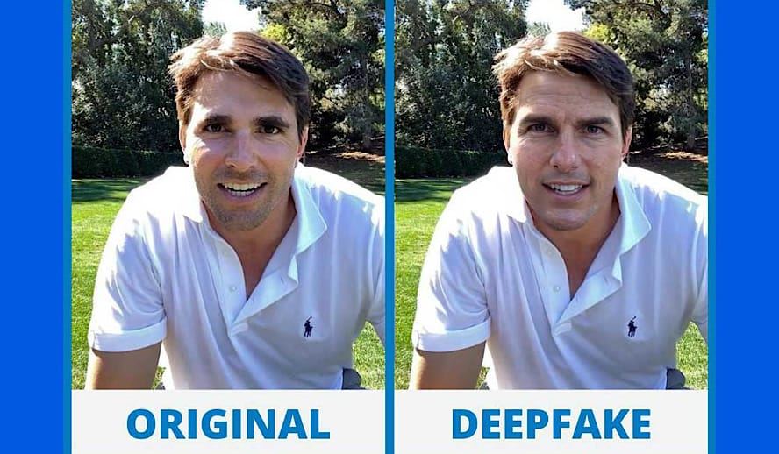
Examples of Deepfakes
Video
Image

Slide 17

Case Studies
Case 1 - Deepfake technology was heavily used in India's 2024 general elections
Case 2 - In 2023, a deepfake video was made of an Indian actress
Case 3 - Deepfake videos of some Indian leaders were made for election

Slide 18

Conclusion
Overview
History
Deepfake technology uses AI to create realistic but fake audio, video, text, and images.
Rapid development in recent years due to improved algorithms and computing power.
Types and Creation Process
Types: Video, audio, image, and text deepfakes.
GANs (Generative Adversarial Networks) and Natural Language Processing (NLP)
Tools and Services
Available tools: DeepFaceLab, FaceSwap, GPT-3 for text deepfakes, and more.
Services: Both commercial and open-source platforms for creating deepfakes.
Advantages and Disadvantages
Entertainment, training tools. and media
Misinformation and fake news
Future Scope
Ongoing advancements in AI.
Case Studies in India
Applications in entertainment and media

Slide 19
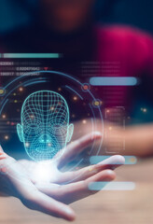
Times of India, March 2024
Deepfake Technology: An Overview
The Hindu, January 2024
The Rise of Deepfake Technology In India
Indian Express. February 2024
Deepfake Technology in India
Economic Times, May 2024
Deepfake Detection Technology: India’s Approach
NDTV, March 2024
Case Studies of Deepfake in India
References

Slide 20
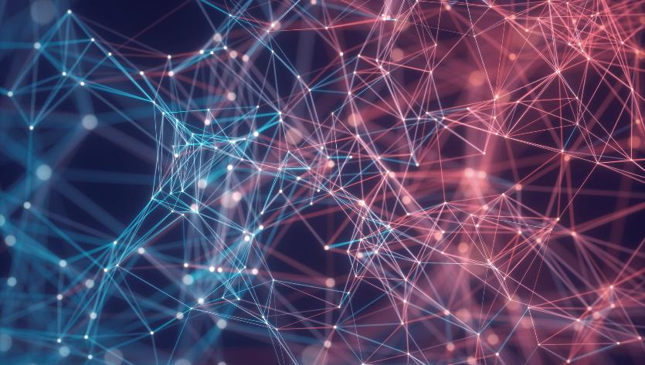

Thank You
Atharva Patharkar
atharvapatharkar6@gmail.com
https://atharvapatharkar.github.io/MyPortfolio/

